Slide 1

TWITTER CLIMATE CHANGE SENTIMENT ANALYSIS
Team Members:
1. Eric Cheruiyot
2. Geoffrey Ongeri
3. Antonia Mulinge

Slide 2
Contents
Introduction
Data Understanding
Deep dive in-to the Tweet Sentiments
Modeling and Validation
Conclusion and Recommendations

Slide 3
Introduction
A changing climate is one of the most world global challenges. This has led to world’s most influential leaders and organizations spearheading the discussion on how to overcome the challenge. In addition twitter is a platform which has led people either support climate change or not.
Problem Statement
Twitter being one of the most influential ways of passing information and analysing trends on various issues and in our case climate change, we chose to analyse tweets data to predict whether a tweet is pro-climate change, anti-climate change , from a news segment or just a neutral part with not take in climate change issues.
We used NN Model as our measure of success

Slide 4
Data Understanding
The dataset contains 43943 rows and 3 columns
The rows represent tweets and each tweet has 3 features representing columns
Sentiment
Message
TweetId
Data Source: Kaggle
Demo: Colab Notebook
Our Target Column: Sentiment - I.e Tweets

Slide 5
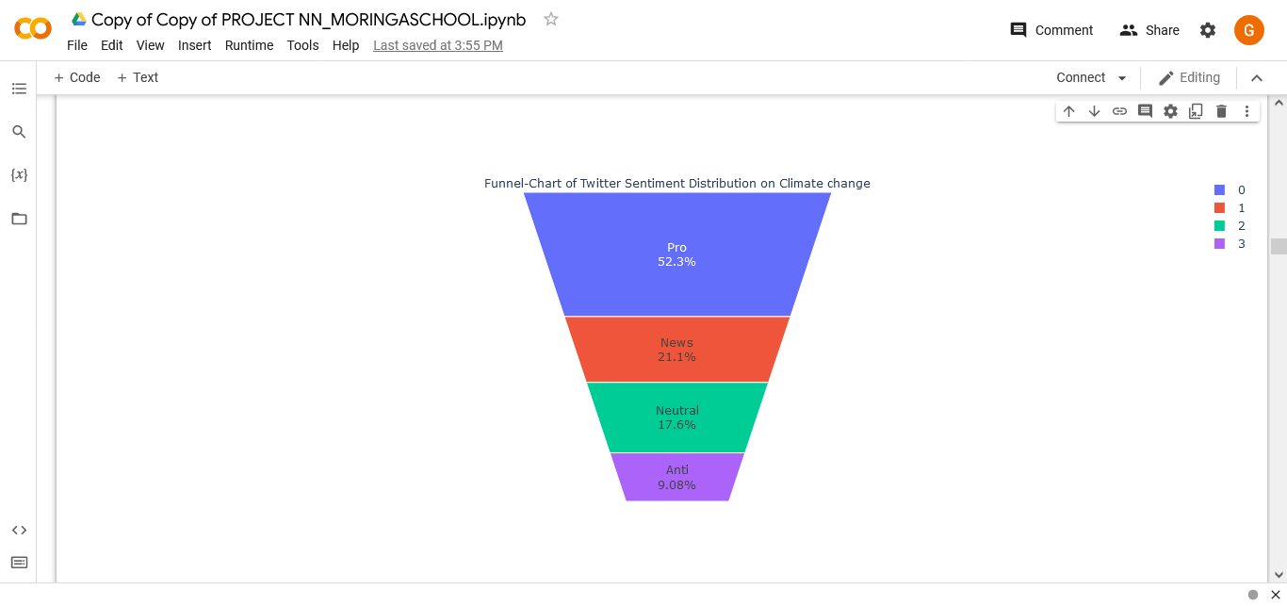
Visualizing the sentiment distribution
Most tweets were from Pro Sentiments With over 22000 tweets

Slide 6
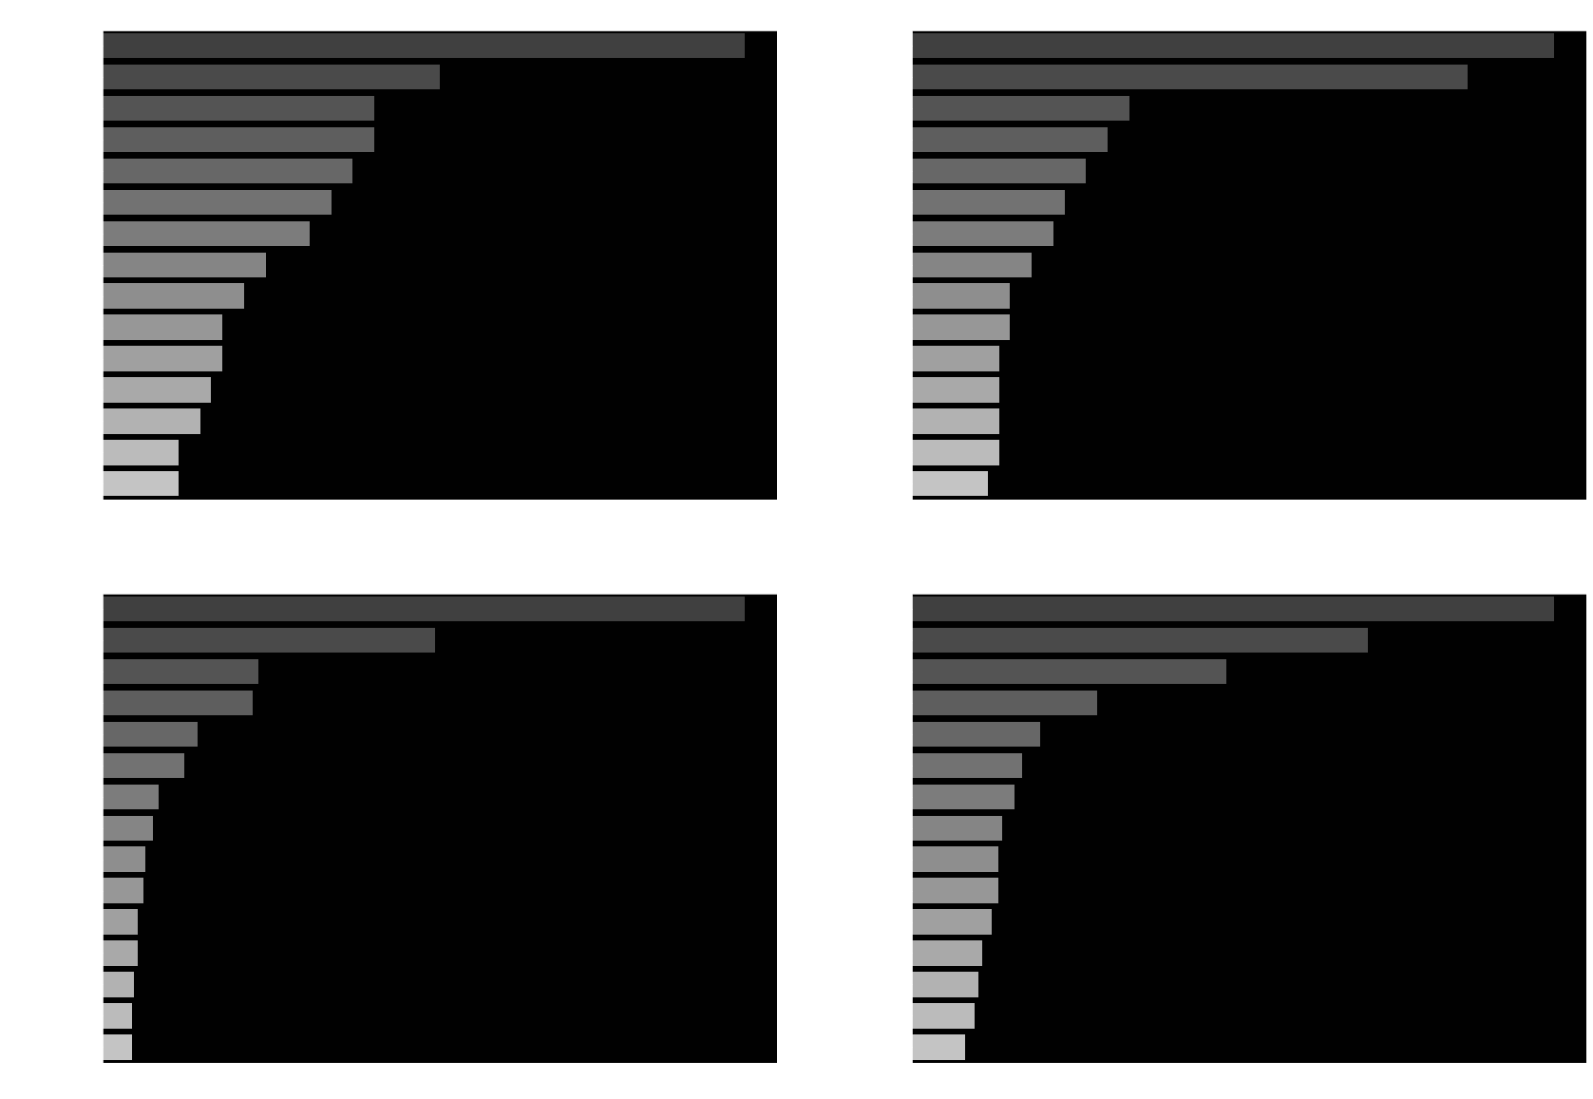
Most Hashtagged Wordings

Slide 7
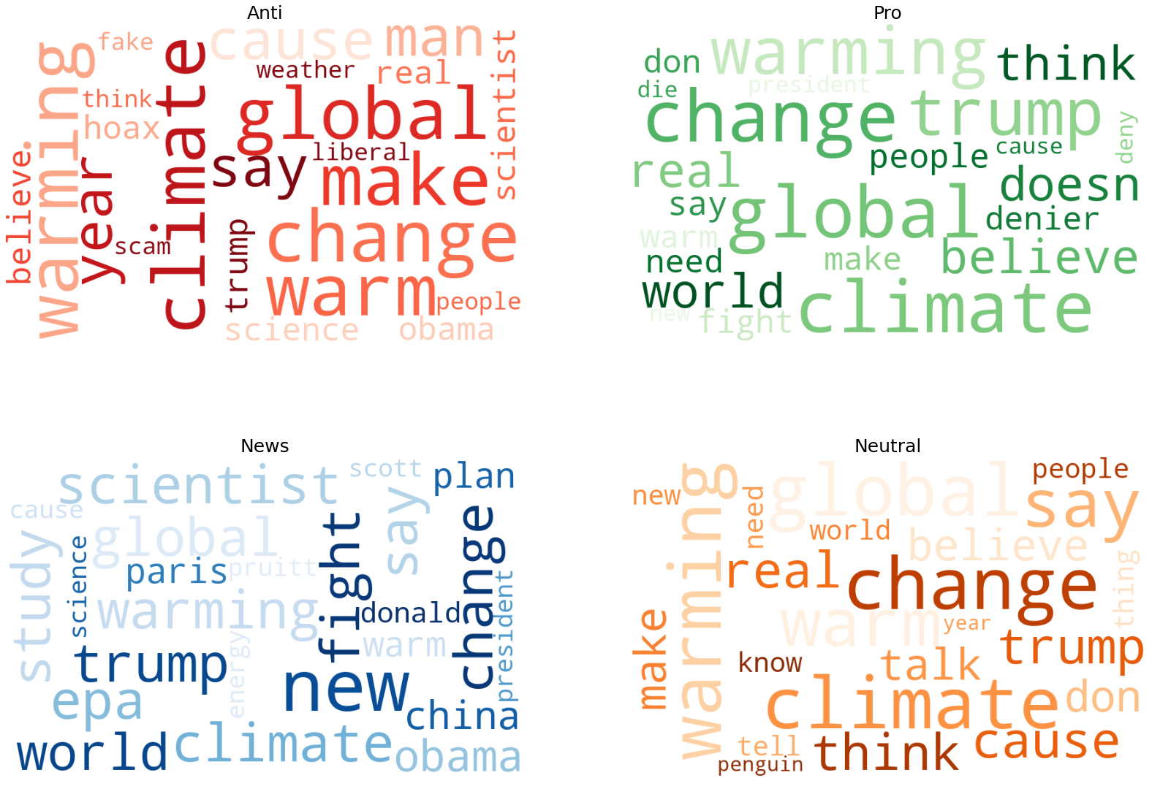
Word Cloud Presentation of top Buzzwords

Slide 8
Modelling
Model Used: Long Short term memory using Tensorflow incorporated with
Keras Functional API and sequential algorithm.
Training size 70%, test size 30%
Model accuracy at 5 epochs : 88%
The LSTM model was validated against Naives bayes and Decision Trees and was found to be the most accurate.

Slide 9
Conclusions and Recommendations
Twitter is a powerful platform to tell how the world feels about climate.
Looking at the BeforeTheFlood hashtag, it is clear that More people are into man-made Climate change leading to scientists, activists, and word leaders to discuss the dangers of climate and and possible solutions
Those against man-made climate change are as a result of believes.

Slide 10
Conclusions and Recommendations (Cont)
COP22, ParisAgreement, and Trump in the Pro sentiment are likely related to the formal process Trump's administration began to exit the Paris Agreements, where north of 200 nations pledged to reduce greenhouse gas emissions, assist developing nations, and assist [poor] nations struggling with the consequences of a warming Earth.
Interestingly, auspol (short for Australian Politics) made the shortlist of the Pro sentiment. This is likely attributed to an assessment published quantifying the role of climate change in Australian bushfires and their increased risk of occuring.

